Slide 1
Chapter 3
Matrix Algebra with MATLAB
Basic matrix definitions and operations were covered in Chapter 2. We will now consider how these operations are performed in MATLAB. All variables in MATLAB are considered as matrices. A simple scalar is considered as a 1 x 1 matrix. For MATLAB variables containing higher dimensions, certain special rules are required to deal with them.

Slide 2
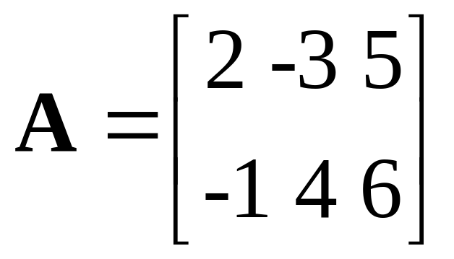
Entering a Matrix in MATLAB
MATLAB Format
>> A = [2 -3 5; -1 4 5]
A =
2 -3 5
-1 4 5

Slide 3
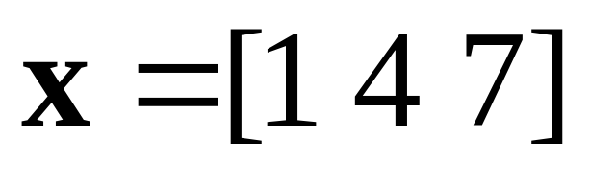
Entering a Row Vector in MATLAB
MATLAB Format
>> x = [1 4 7]
x =
1 4 7

Slide 4
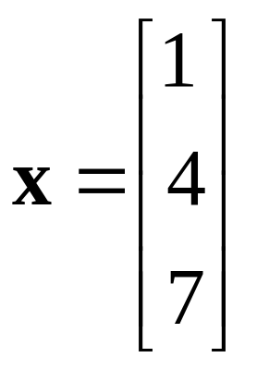
Entering a Column Vector in MATLAB
MATLAB Format
>> x = [1; 4; 7]
x =
1
4
7

Slide 5
Alternate Way to Enter a Column Vector
>> x = [1 4 7]'
x =
1
4
7

Slide 6
Matrix Addition and Subtraction
Matrix addition and subtraction with MATLAB are achieved in the same manner as with scalars provided that the matrices have the same size. Typical expressions are shown below.
>> C = A + B
>> D = A - B

Slide 7
Error Messages
MATLAB has many error messages that indicate problems with operations. If the matrices have different sizes, the message is
??? Error using ==> ±
Matrix dimensions must agree.

Slide 8
Matrix Multiplication
Matrix multiplication with MATLAB is achieved in the same manner as with scalars provided that the number of columns of the first matrix is equal to the number of rows of the second matrix. A typical expression is
>> E = A*B

Slide 9
Array Multiplication
There is another form of multiplication of matrices in which it is desired to multiply corresponding elements in a fashion similar to that of addition and subtraction. This operation arises frequently with MATLAB, and we will hereafter refer to the process as the array product to distinguish it from the standard matrix multiplication form.

Slide 10

Array Multiplication Continuation
For the array product to be possible, the two matrices must have the same size, as was the case for addition and subtraction. The resulting array product will have the same size. If F represents the resulting matrix, a given element of F, denoted by f_{ij} is determined by the corresponding product from the two matrices as

Slide 11
MATLAB Array Multiplication
To form an array product in MATLAB, a period must be placed after the first variable. The operation is commutative. The following two operations produce the same result.
>> F=A.*B
>> F=B.*A

Slide 12
MATLAB Array Multiplication Continuation
If there are more than two matrices for which array multiplication is desired, the periods should follow all but the last one in the expression; e. g., A.*B.*C in the case of three matrices. Alternately, nesting can be used; e.g. (A.*B).*C for the case of three matrices.

Slide 13
MATLAB Array Multiplication Continuation
The array multiplication concept arises in any operation in which the command could be “confused” for a standard matrix operation. For example, suppose it is desired to form a matrix B from a matrix A by raising each element of A to the 3rd power, The MATLAB command is
>> B = A.^3

Slide 14
Determinant of a Matrix
The determinant of a square matrix in MATLAB is determined by the simple command det(A). Thus, if a is to represent the determinant, we would type and enter
>> a = det(A)
Note that a is a scalar (1 x 1 "matrix").

Slide 15
Inverse Matrix
The inverse of a square matrix in MATLAB is determined by the simple command inv(A). Thus, if B is to represent the inverse of A , the command would be
>> B = inv(A)

Slide 16

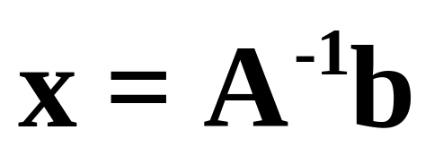
Simultaneous Equation Solution
MATLAB Format:
>> x = inv(A)*b
Alternate MATLAB Format:
>> x = A\b

Slide 17
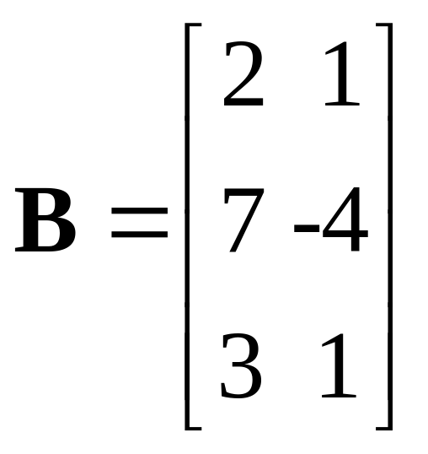
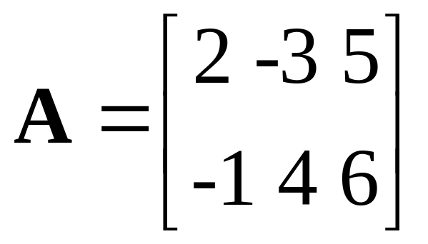
Example 3-1. Enter the matrices below in MATLAB. They will be used in the next several examples.
>> A = [2 -3 5; -1 4 6];
>> B = [2 1; 7 -4; 3 1];

Slide 18
Example 3-2. Determine the transpose of B and denote it as C.
>> C = B'
C =
2 7 3
1 -4 1
The 3 x 2 matrix has been converted to a 2 x 3 matrix.

Slide 19
Example 3-3. Determine the sum of A and C and denote it as D.
>> D = A + C
D =
4 4 8
0 0 7

Slide 20
Example 3-4. Determine the product of A and B with A first.
>> A*B
ans =
-2 19
44 -11

Slide 21
Example 3-5. Determine the product of B and A with B first.
>> B*A
ans =
3 -2 16
18 -37 11
5 -5 21

Slide 22
Example 3-6. Determine the array product of A and C and denote it as E.
>> E = A.*C
E =
4 -21 15
-1 -16 6

Slide 23
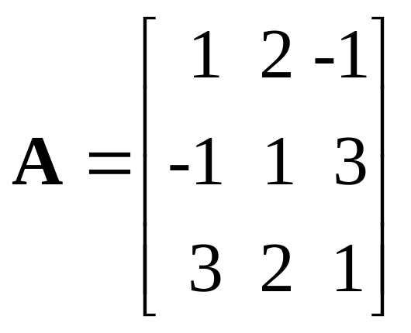
Example 3-7. Enter the matrix A. It will be used in several examples.
>> A = [1 2 -1; -1 1 3; 3 2 1]
A =
1 2 -1
-1 1 3
3 2 1

Slide 24
Example 3-7. Continuation. Determine the determinant of A and denote it as a.
>> a = det(A)
a =
20

Slide 25
Example 3-8. Determine the inverse matrix of A and denote it as Ainv.
>> Ainv = inv(A)
Ainv =
-0.2500 -0.2000 0.3500
0.5000 0.2000 -0.1000
-0.2500 0.2000 0.1500

Slide 26
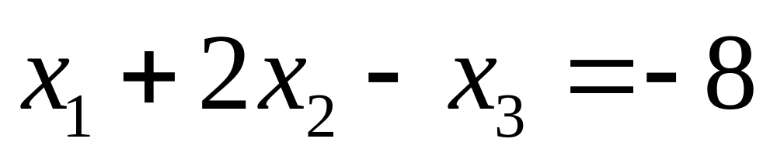
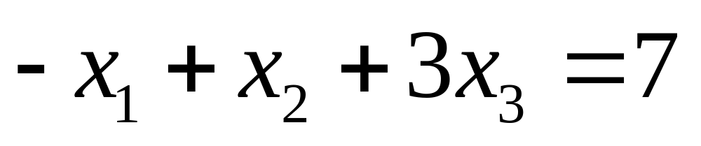
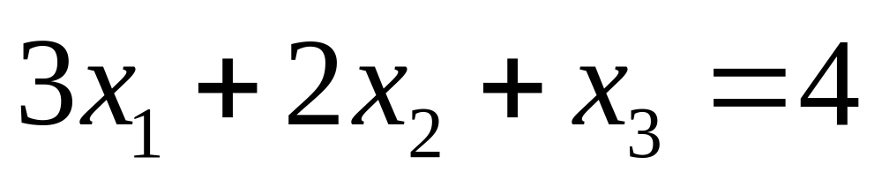
Example 3-9. Use MATLAB to solve the simultaneous equations below.

Slide 27
Example 3-9. Continuation.
Assume that A is still in memory.
>> b = [-8; 7; 4]
b =
-8
7
4

Slide 28
Example 3-9. Continuation.
>> x = inv(A)*b
x =
2.0000
-3.0000
4.0000

Slide 29
Example 3-9. Continuation.
Alternately,
>> x = A\b
x =
2.0000
-3.0000
4.0000

